Slide 1

Claims Data Insights

Slide 2
Key Variables for analysis
TPI: third party injury – claims arising when a driver causes personal injury to other persons for which he/she is liable.
TPD Estimate - This is an estimate of the expected cost for property damage claims made by third parties.
TPD: third party damage – claims arising when a driver causes damage to the property of other persons for which he/she is liable.
Total claimants –total number of unique individuals who’ve submitted a claim. This variable helps in understanding the frequency and incidence of claims.
Total Cost Movement - Definition: This represents the change in total costs over a specific period. It can be calculated as the difference in total costs between two time points, indicating whether costs have increased, decreased, or remained stable.
Total Cost - This is the aggregate amount of money spent or incurred due to claims within a specific period or for a specific client. It includes all associated expenses such as settlements, legal fees, and other related costs.

Slide 3
Total Cost Analysis

Slide 4
Changes in total cost from 2022 to 2023
Overall increase in total cost of claims of £2,502,552.05
This increase is a 31.92% increase
Factors affecting total cost have increased, increasing total cost

Slide 5
Are the results significant?
T-test was used to test whether there was a significant difference in the 2022 and 2023 total cost results
P-value calculated < 0.05
This means that there was a statistically significant difference between total costs in year 2022 and 2023

Slide 6
Distribution of Total Cost
Every few months there’s an increase in the total cost of claims
Most events have low total costs
Temporal variability in the frequency and size of the claims
Very few very high cost claims
Vague 3 monthly large increase

Slide 7
Fault categorization
Buses are the most frequently occurring vehicle involved in claims
Indicates that depots’ and clients’ operations lead to incidents that involve buses
Other vehicles, apart from buses and motors, have minimal representation across most fault categories
Data Quality and Recording – There is a fair amount of data that had insufficient information

Slide 8
Sequential analysis

Slide 9
Total cost change
Calculated by how much total cost changed, relative to the cost of a claim with a corresponding preceding date
Thus showed the distribution of total cost change per accident date
The appearance of large total cost changes appear gradually and every few months
This likely indicates regular operational factors affecting the total cost change magnitudes
Random/unusual increases in total cost change magnitude might indicate fraudulent activities. This

Slide 10
Total Cost Movement
Total cost movement was calculated using the total cost and total cost from last report period 01 data
Total cost movement shows a fair amount of variability
This suggests high claim management efficiency
The range in costs might reflect the efficiency and variability in claim management processes.
High-cost differences may require review to understand the underlying reasons and whether they can be managed or reduced in future.
Notes:
No discernible pattern

Slide 11
Cluster analysis

Slide 12
Distribution of different clusters across time
Cluster analysis was performed to cluster claims’ total cost
Cluster 0 had only 1 pair of strongly correlated variables, Cluster 2 had 3 pairs
From Cluster 0 to Cluster 2 there’s an increase in the number of pairs of strongly correlated variables
Three clusters were identified

Slide 13
Cluster characteristics
Cluster 0:
Largest cluster
Wide range of total costs; noticeable correlation between total cost movement and total claimants.
Represents the bulk of data with variable costs, suggesting diverse claim types and severities
Cluster 1:
Extremely small cluster – only 3 data points, making it an outlier or rare segment.
Due to severity of size, analysis and results weren’t meaningful
Cluster 2:
Moderately small cluster
More consistent total costs;
Contained the most pairs of variables strongly correlated
predictable costs that are easier to manage

Slide 14
Correlation matrix per cluster
 |  |  |  |  |  |  |  |  |  |  |  |  | Cluster group Correlation Matrices
 |  | Cluster 0 |  |  |  |  |  |  |  |  |  |  |  | Cluster 1 |  |  |  |  |  |  |  |  |  | Cluster 2
 | Tpi Estimate | Total Cost | Last Report Period01 Total Cost | Total Cost Movement | Total Claimants |  |  |  | Tpd Paid | Tpd Estimate | Ad Paid | Ad Estimate | Tpi Paid | Tpi Estimate | Total Cost | Last Report Period01 Total Cost | Total Cost Movement | Total Claimants |  |  |  | Ad Paid | Tpi Estimate | Total Cost | Last Report Period01 Total Cost | Total Cost Movement | Total Claimants
Tpi Estimate | 1 | -0.04087 | 0.089445 | -0.01029 | -0.02548 |  |  | Tpd Paid | 1 | 0.568827 |  |  | -0.64478 | -0.47514 | 0.338747 | -0.45371 | 0.543519 | -0.1264 |  |  | Ad Paid
Total Cost | -0.04087 | 1 | -0.01537 | 0.209982 | 0.234106 |  |  | Tpd Estimate | 0.568827 | 1 |  |  | -0.5851 | -0.38663 | -0.28586 | -0.51177 | 0.997934 | 0.362908 |  |  | Tpi Estimate |  | 1 | 0.578993 | 0.716525 | -0.03368 | 0.17205
Last Report Period01 Total Cost | 0.089445 | -0.01537 | 1 | 0.474375 | 0.525851 |  |  | Ad Paid |  |  |  |  |  |  |  |  |  |  |  |  | Total Cost |  | 0.578993 | 1 | 0.740171 | -0.0139 | 0.075083
Total Cost Movement | -0.01029 | 0.209982 | 0.474375 | 1 | 0.897503 |  |  | Ad Estimate |  |  |  |  |  |  |  |  |  |  |  |  | Last Report Period01 Total Cost |  | 0.716525 | 0.740171 | 1 | -0.05136 | 0.267205
Total Claimants | -0.02548 | 0.234106 | 0.525851 | 0.897503 | 1 |  |  | Tpi Paid | -0.64478 | -0.5851 |  |  | 1 | 0.937268 | 0.29073 | 0.939215 | -0.55207 | 0.511682 |  |  | Total Cost Movement |  | -0.03368 | -0.0139 | -0.05136 | 1 | 0.007407
 |  |  |  |  |  |  |  | Tpi Estimate | -0.47514 | -0.38663 |  |  | 0.937268 | 1 | 0.466887 | 0.981586 | -0.34539 | 0.713471 |  |  | Total Claimants |  | 0.17205 | 0.075083 | 0.267205 | 0.007407 | 1
 |  |  |  |  |  |  |  | Total Cost | 0.338747 | -0.28586 |  |  | 0.29073 | 0.466887 | 1 | 0.569128 | -0.28167 | 0.173293
 |  |  |  |  |  |  |  | Last Report Period01 Total Cost | -0.45371 | -0.51177 |  |  | 0.939215 | 0.981586 | 0.569128 | 1 | -0.47795 | 0.588893
 |  |  |  |  |  |  |  | Total Cost Movement | 0.543519 | 0.997934 |  |  | -0.55207 | -0.34539 | -0.28167 | -0.47795 | 1 | 0.405959
 |  |  |  |  |  |  |  | Total Claimants | -0.1264 | 0.362908 |  |  | 0.511682 | 0.713471 | 0.173293 | 0.588893 | 0.405959 | 1
A correlation matrix was calculated for each cluster
This shows, in each cluster which variables were correlated

Slide 15
Cluster 2 further analysis
For each cluster, I performed a regression analysis on variables that were strongly correlated in the correlation matrix
Cluster 2 analysis shows:
P value was 0.002375
Very strong, positive and statistically significant relationship present between tpi estimate and last report period total cost
In practical terms, decision-makers can use the TPI estimate to make informed predictions about last report period total cost

Slide 16
Cluster 2 further analysis
P value was < 0.05.
Strong positive , statistically significant relationship present between last report period total cost and total cost

Slide 17
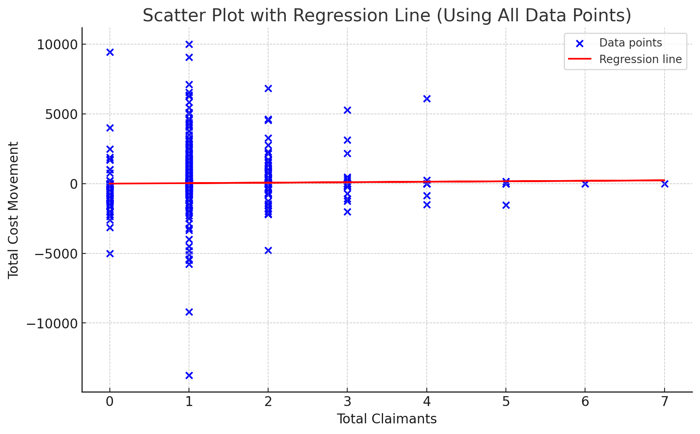
Cluster 0 further analysis
Cluster 0 analysis shows:
P value < 0.05 , R-squared: 0.002
Very strong positive relationship present between total claimants and total cost movement
, R-squared value being so low indicates that that the model does not explain much of the variability in the total cost movement.

Slide 18
Measuring impact of number of case claimants
For a claim, as the number of claimants increase the magnitude of the total cost movement generally decreases
As the number of total claimants increases past 4 the total cost change becomes negative
Notes:
For a claim, as the number of claimants increase the magnitude of the total cost movement generally decreases
As the number of total claimants increases past 4 the total cost change becomes negative

Slide 19
Measuring the number of claims per cluster per client

Slide 20
Number of claims per cluster per client results
They show that generally most of any individual client’s claims belonged to cluster 0
Business 10 had the greatest relative amount of claims in cluster 0
These results are fairly expected

Slide 21
Measuring frequency of cluster in each vehicle category
In the vehicle categories with the most claims , claims belonging to cluster 0 far outnumbered the ones belonging to cluster 2

Slide 22
THE END

